Slide 1
McDonald Valley
A Model Calibration Exercise for MODFLOW

Slide 2
The ”Truth”
nlay, nrow, ncol = 5, 200, 125
Lake simulated as high K
Hydraulic properties generated using geostats simulator

Slide 3
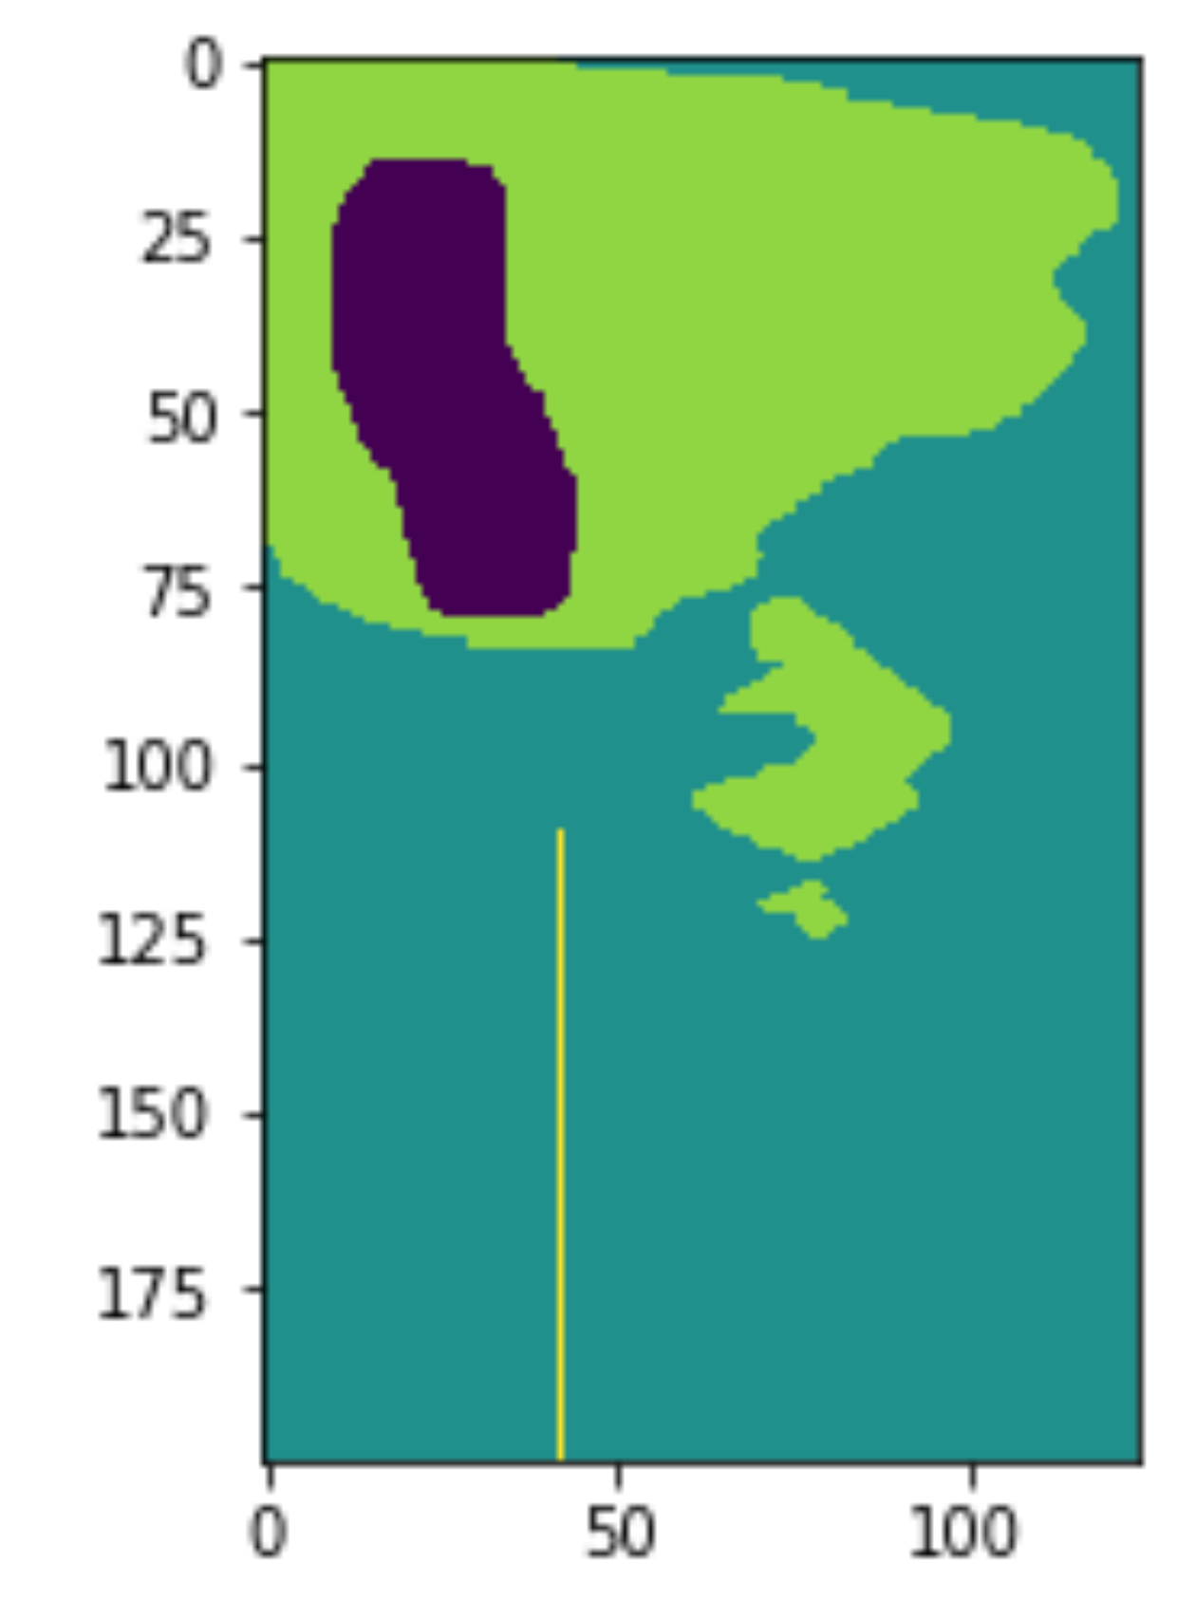
Clay Location

Slide 4
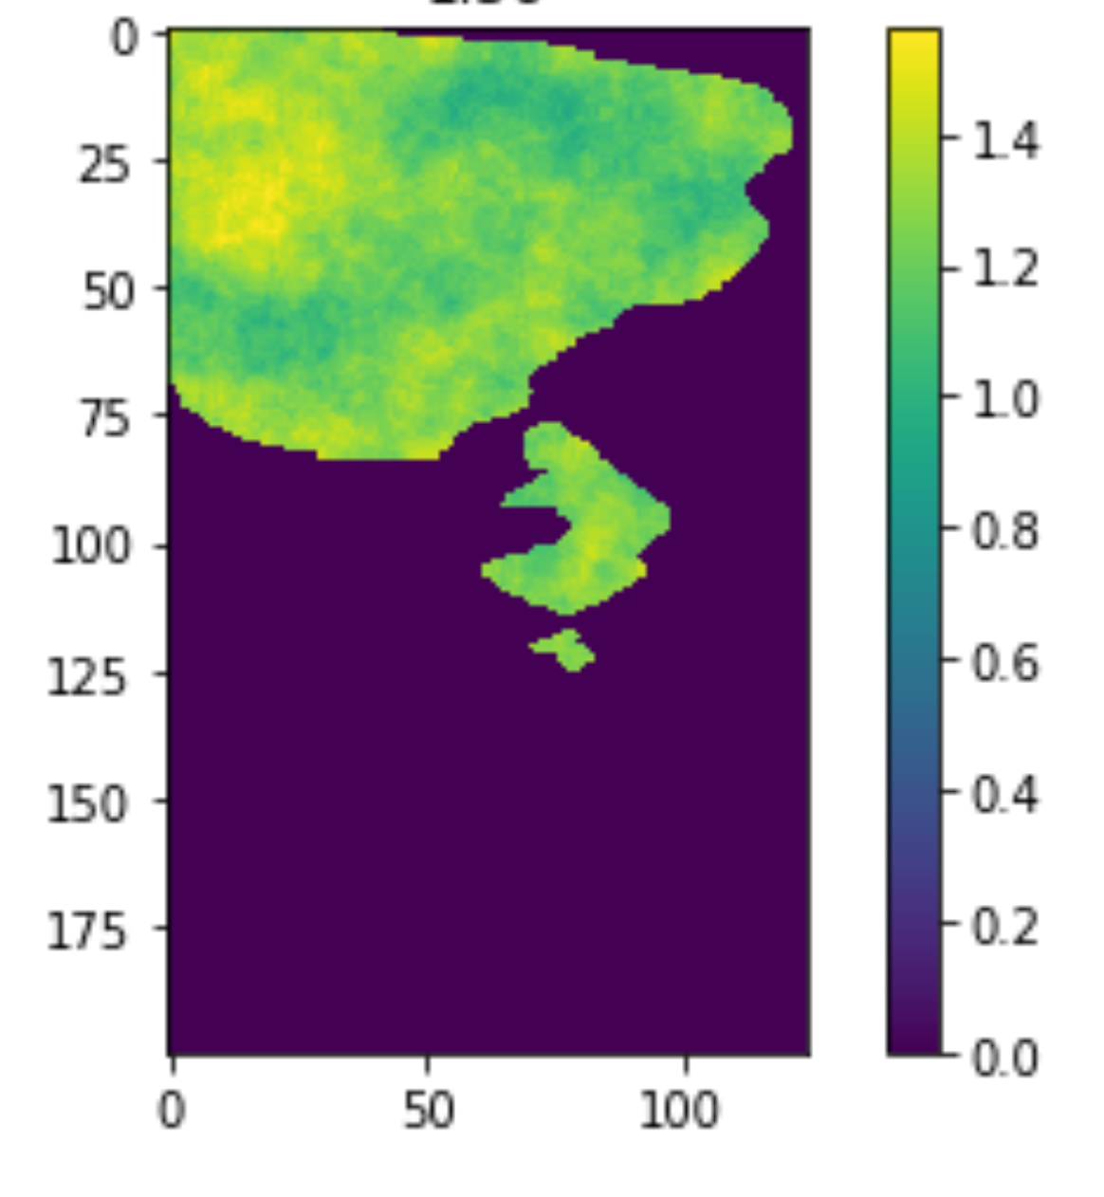
Clay Thickness

Slide 5
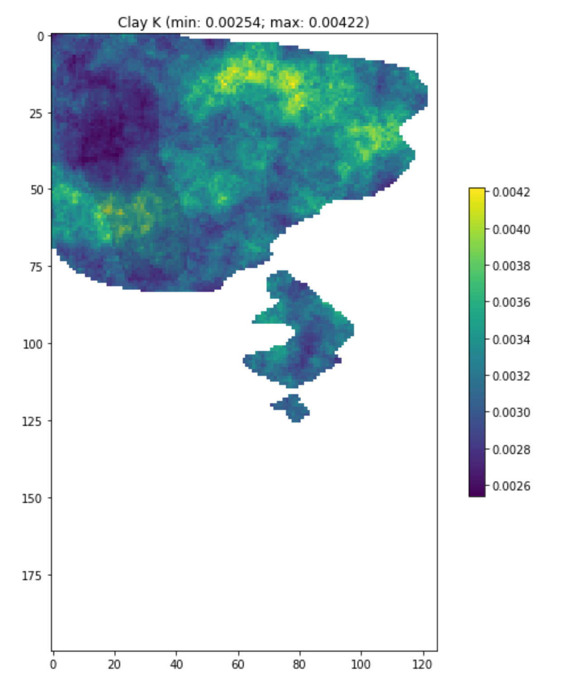

Slide 6
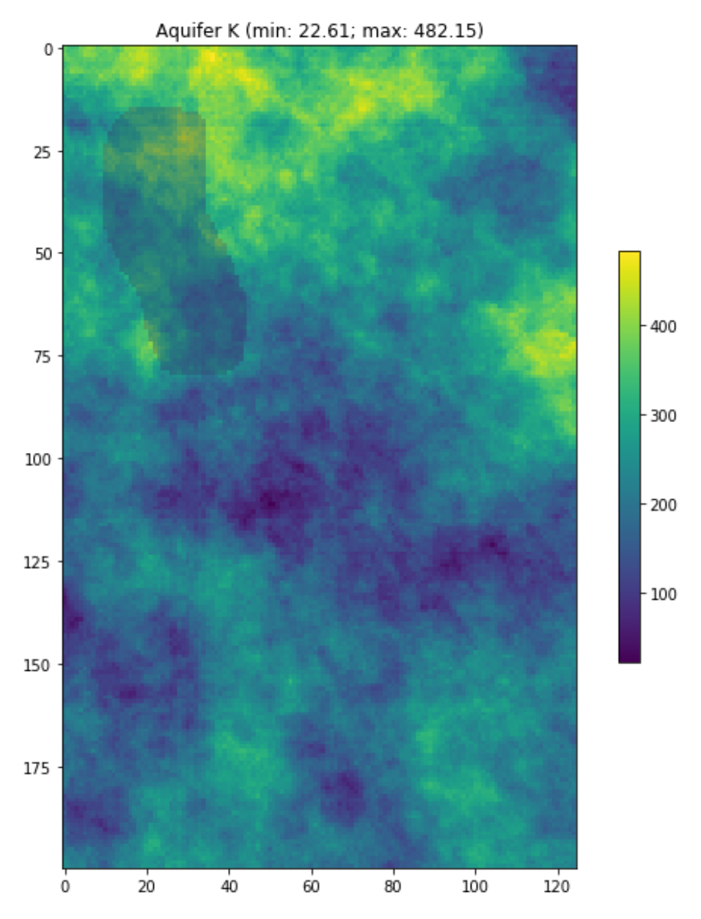
Aquifer Horizontal K

Slide 7
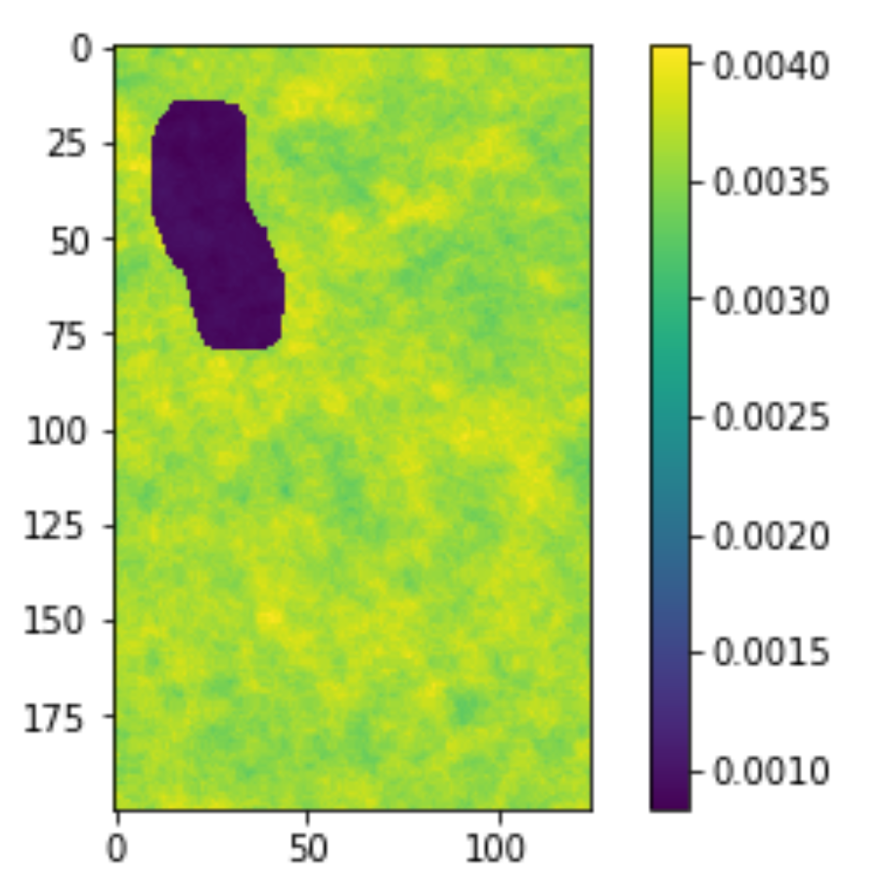
Recharge Variation

Slide 8
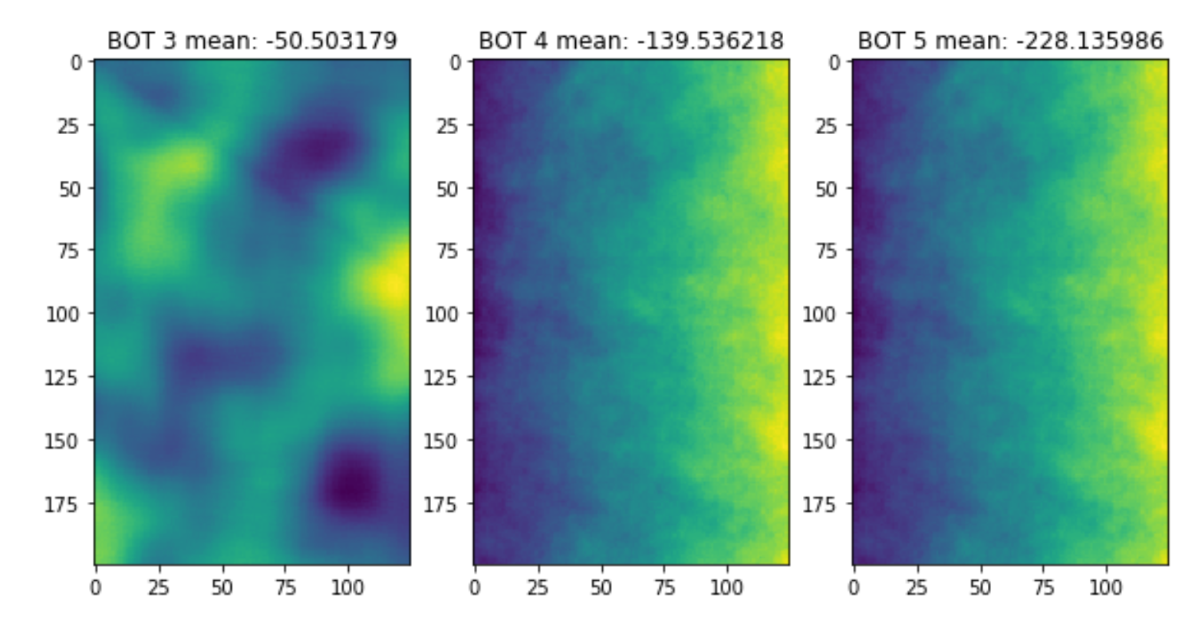
Layer Bottom

Slide 9
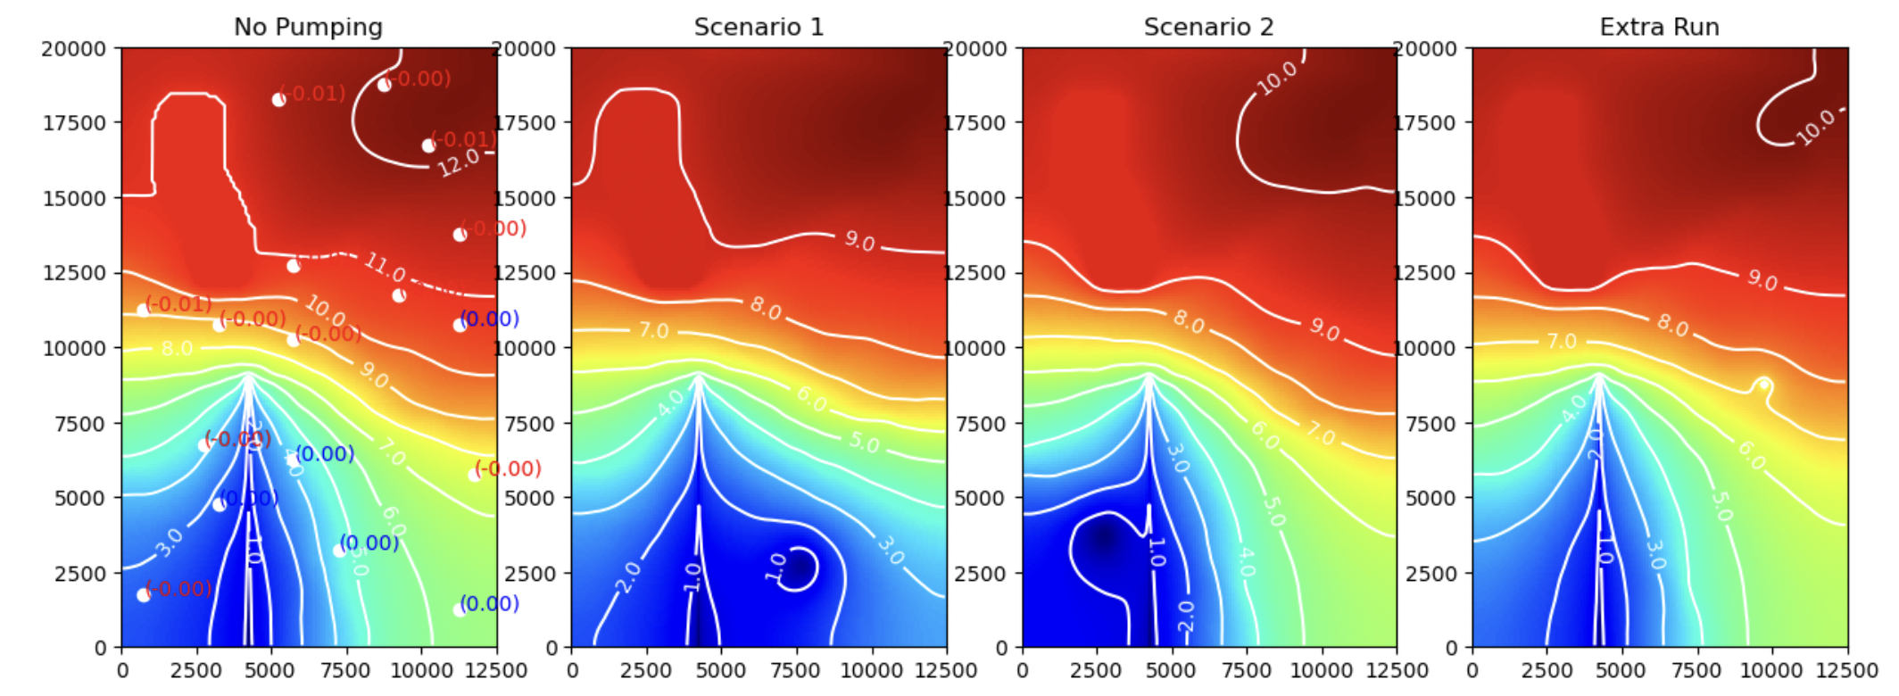
Predictions

Slide 10
Predictions: Lake Stage
No pumping (base): 11.000035 feet
scenario A: 8.950215 feet
scenario B: 9.334531 feet
Extra Run: 9.23731 feet

Slide 11
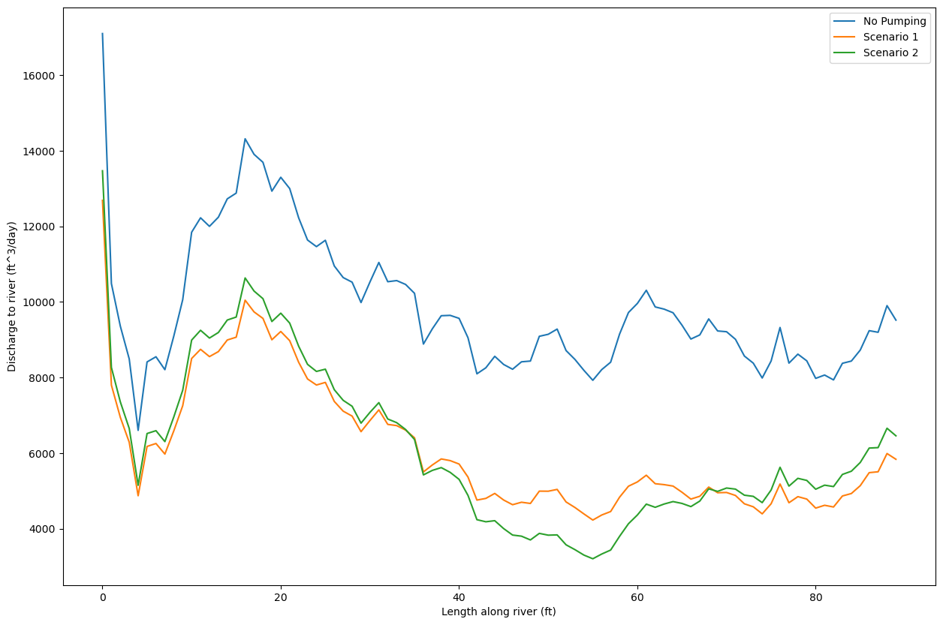
Discharge to River

